Slide 1

Deriving AF phenotypes clusters from AI-ECG methods on patients with persistent atrial fibrillation

Slide 2
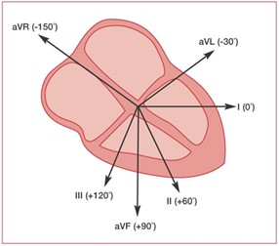
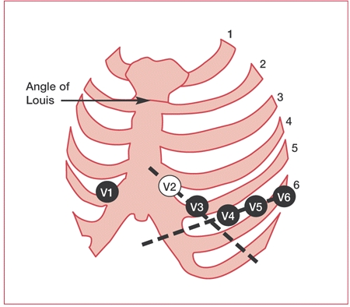
What is an ECG and what is Atrial fibrillation (AF)
Distal limbs
ECG gives healthcare professionals an approximation of the heart's electric conductivity
AF 37,574 million prevalence and incidence risen 37% from 1997 ₁
Due to its link to increasing stroke by 3-5-fold it continues to be a large focus of cardiovascular research ₂
Types of AF are characterised by the time ₅
₃
Chest leads
₄
Notes:
These statistics are taken from : Wolf, P.A. et al. (1978) ‘Epidemiologic assessment of chronic atrial fibrillation and risk of stroke: The fiamingham Study’, Neurology, 28(10), pp. 973–973. Available at: https://doi.org/10.1212/WNL.28.10.973.
These is based on research from : Lippi, G., Sanchis-Gomar, F. and Cervellin, G. (2021) ‘Global epidemiology of atrial fibrillation: An increasing epidemic and public health challenge’, International Journal of Stroke: Official Journal of the International Stroke Society, 16(2), pp. 217–221. Available at: https://doi.org/10.1177/1747493019897870.
This figure shows the relation ship of the distal limb leads and the heart and has been taken from : Ashley, E.A. and Niebauer, J. (2004) ‘Conquering the ECG’, in Cardiology Explained. Remedica. Available at: https://www.ncbi.nlm.nih.gov/books/NBK2214/ (Accessed: 10 August 2023).
This figure shows the 6 leads placement for the V1-V6 leads :Ashley, E.A. and Niebauer, J. (2004) ‘Conquering the ECG’, in Cardiology Explained. Remedica. Available at: https://www.ncbi.nlm.nih.gov/books/NBK2214/ (Accessed: 10 August 2023).
The way atrial fribillation is categorized is mentioned here : Zoni-Berisso, M. et al. (2014) ‘Epidemiology of atrial fibrillation: European perspective’, Clinical Epidemiology, 6, pp. 213–220. Available at: https://doi.org/10.2147/CLEP.S47385.

Slide 3
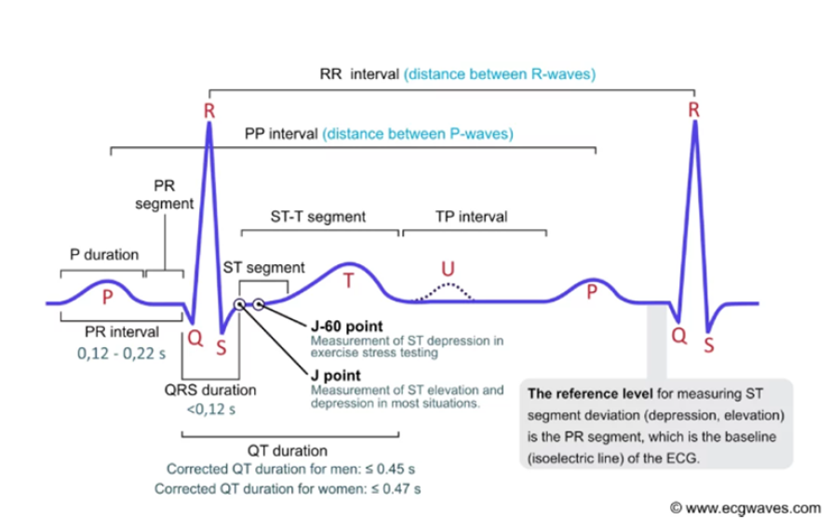
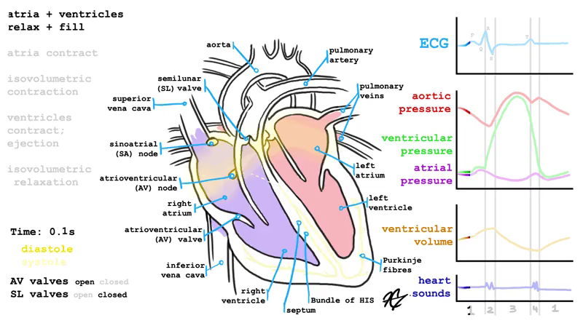
AF Presentation
Normal ECG signal characterized by :
p wave = atrial depolarization
large narrow QRS peak = ventricular depolarization
AF ECG :
More irregular p waves = constant atrial fibrillation
Irregular QRS peaks = inefficient ventricular depolarisation
Enlarged atrial dimensions
₆
7
Notes:
6. The ECG interpretation is informed from : ‘ECG interpretation: Characteristics of the normal ECG (P-wave, QRS complex, ST segment, T-wave)’ (2023) ECG & ECHO. Available at: https://ecgwaves.com/topic/ecg-normal-p-wave-qrs-complex-st-segment-t-wave-j-point/ (Accessed: 11 August 2023).
7.This figure is a video about the hearts cardiac cycle from : Heart Anatomy GIF - Heart Anatomy - Discover & Share GIFs (no date). Available at: https://media.tenor.com/A4kkuHggV0sAAAAC/heart-anatomy.gif (Accessed: 13 September 2023).

Slide 4
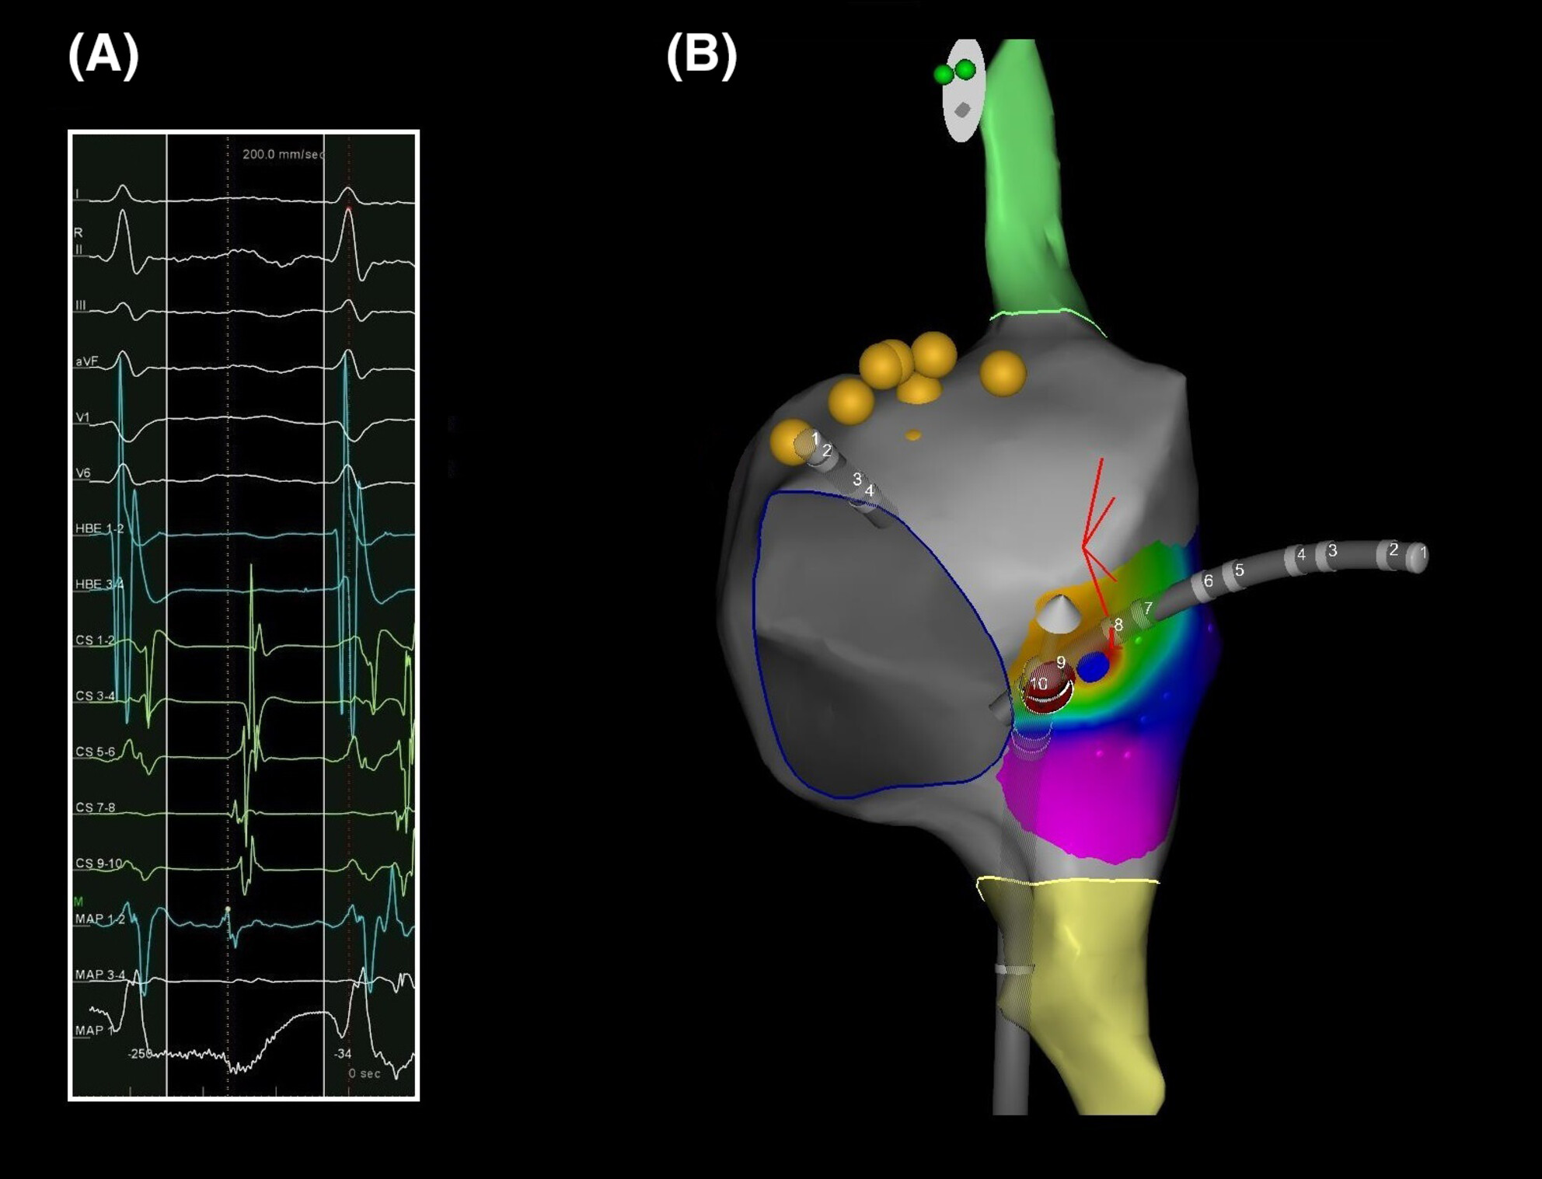
Current Treatment ( Catheter ablation)
AF heterogenous disease , requires exploratory approach to treatment
Final treatment solution, PVI catheter ablation
Pulmonary vein tissue targeted and ablated responsible for irregular heart rhythm ₈
Success rates are low (50%)₉
₁₀
Notes:
8. Information on pulmonary vein isolation is taken from : Pulmonary Vein Isolation (PVI) Ablation (no date) Cleveland Clinic. Available at: https://my.clevelandclinic.org/health/treatments/17401-pulmonary-vein-isolation-ablation (Accessed: 13 September 2023).
9. Success rates are based on the CAPLA trial : Chieng, D. et al. (2022) ‘Catheter ablation for persistent atrial fibrillation: A multicenter randomized trial of pulmonary vein isolation (PVI) versus PVI with posterior left atrial wall isolation (PWI) - The CAPLA study’, American Heart Journal, 243, pp. 210–220. Available at: https://doi.org/10.1016/j.ahj.2021.09.015.
10.Figure taken from segment of figure from : Ciriello, G.D. et al. (2023) ‘Contact force sensing radiofrequency catheter ablation guided by electroanatomic mapping in pediatric patients with permanent junctional reciprocating tachycardia: A case series’, Journal of Arrhythmia, 39(4), pp. 653–657. Available at: https://doi.org/10.1002/joa3.12877.

Slide 5
Solutions (AF phenotypes )
There has been research to further categorise AF looking for new AF phenotypes
This will help us find improved more tailor fitted treatment based on characteristics of different groups
Current research clusters on patient information and forms clusters based on risk factors , gender and comorbidities ₁₁
Notes:
11.Current research on clusters taken from : Vitolo, M. et al. (2021) ‘Clinical Phenotype Classification of Atrial Fibrillation Patients Using Cluster Analysis and Associations with Trial-Adjudicated Outcomes’, Biomedicines, 9(7), p. 843. Available at: https://doi.org/10.3390/biomedicines9070843.

Slide 6
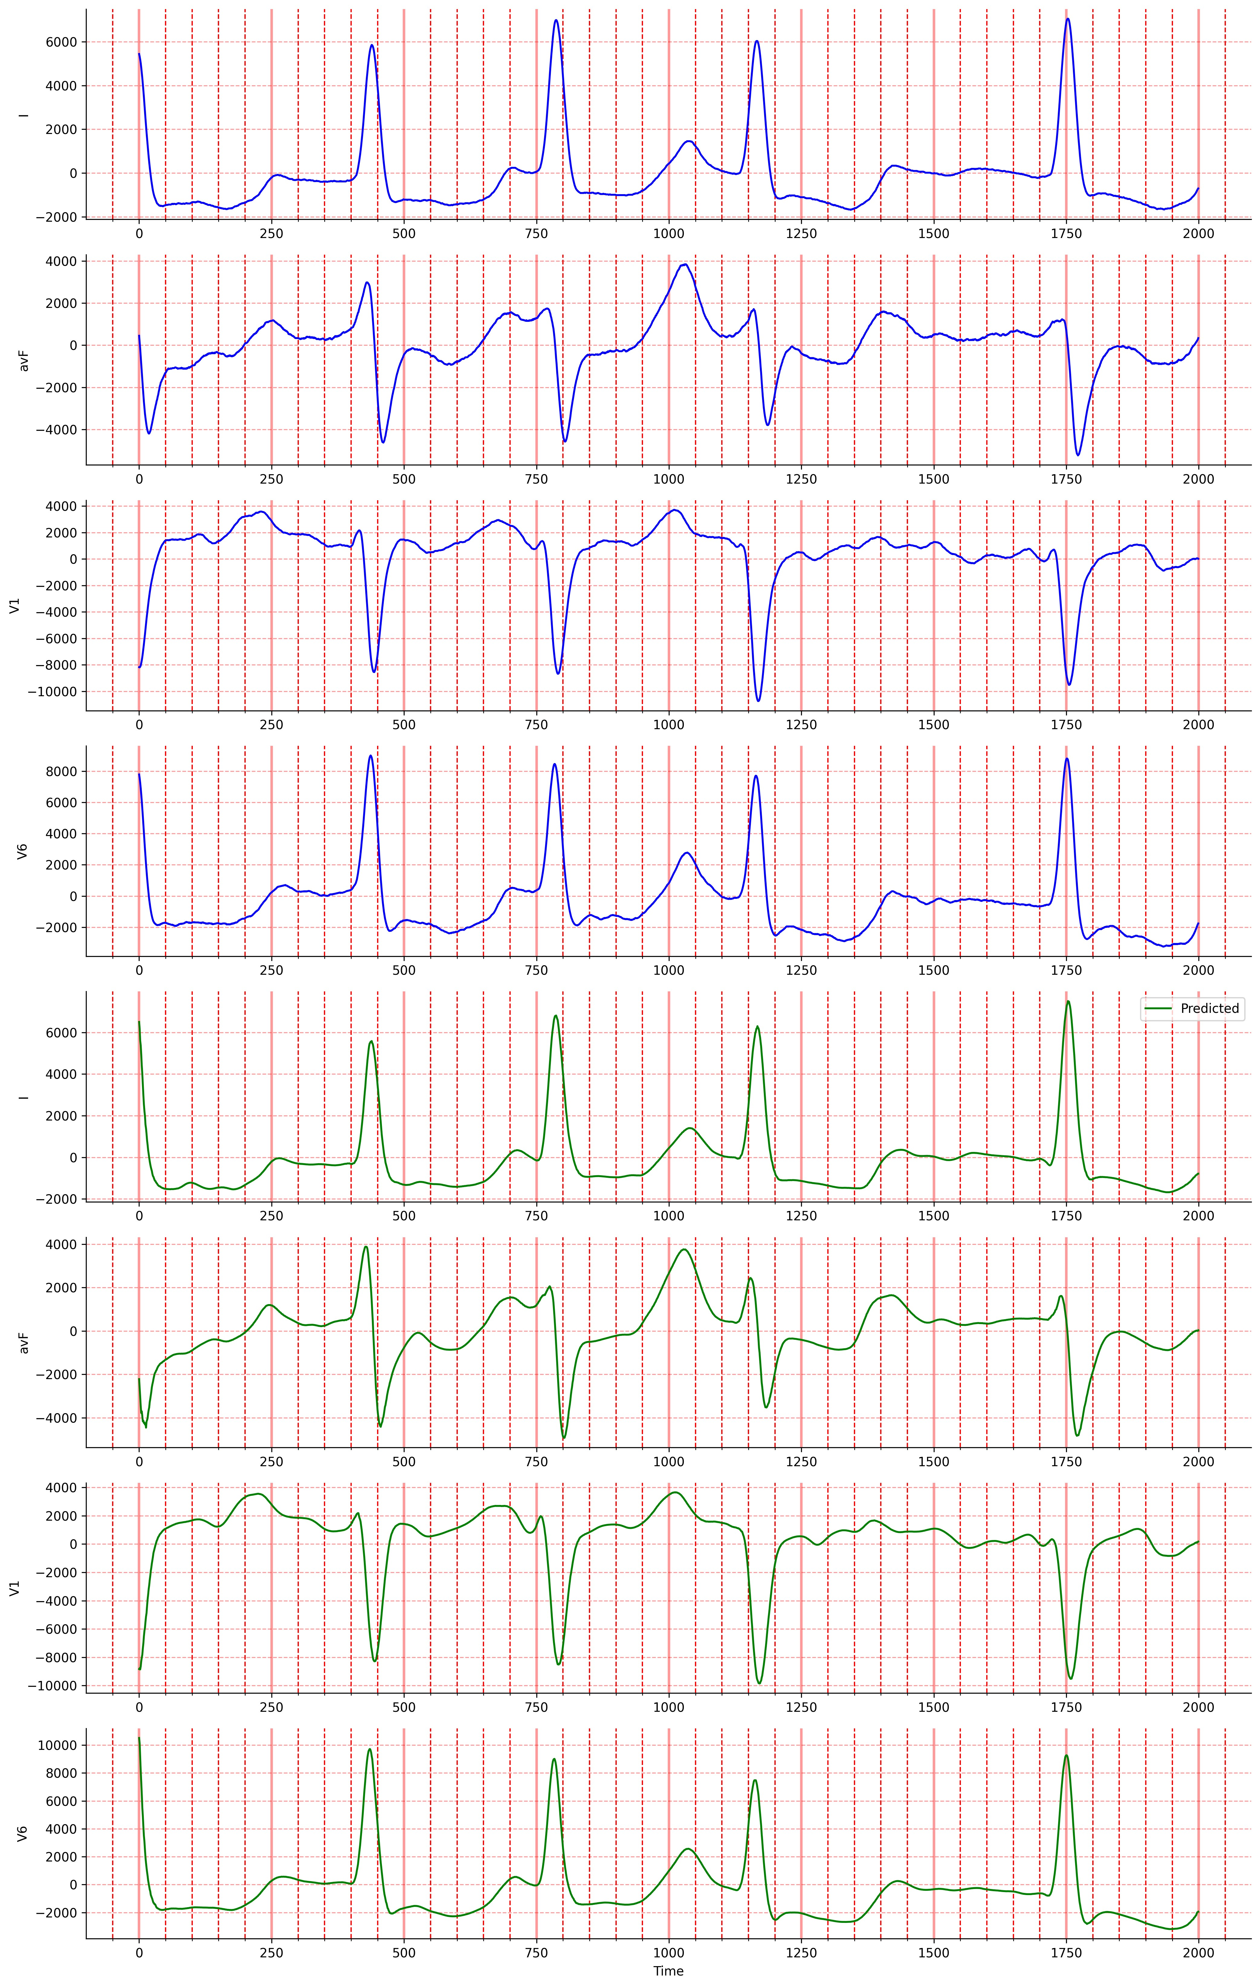
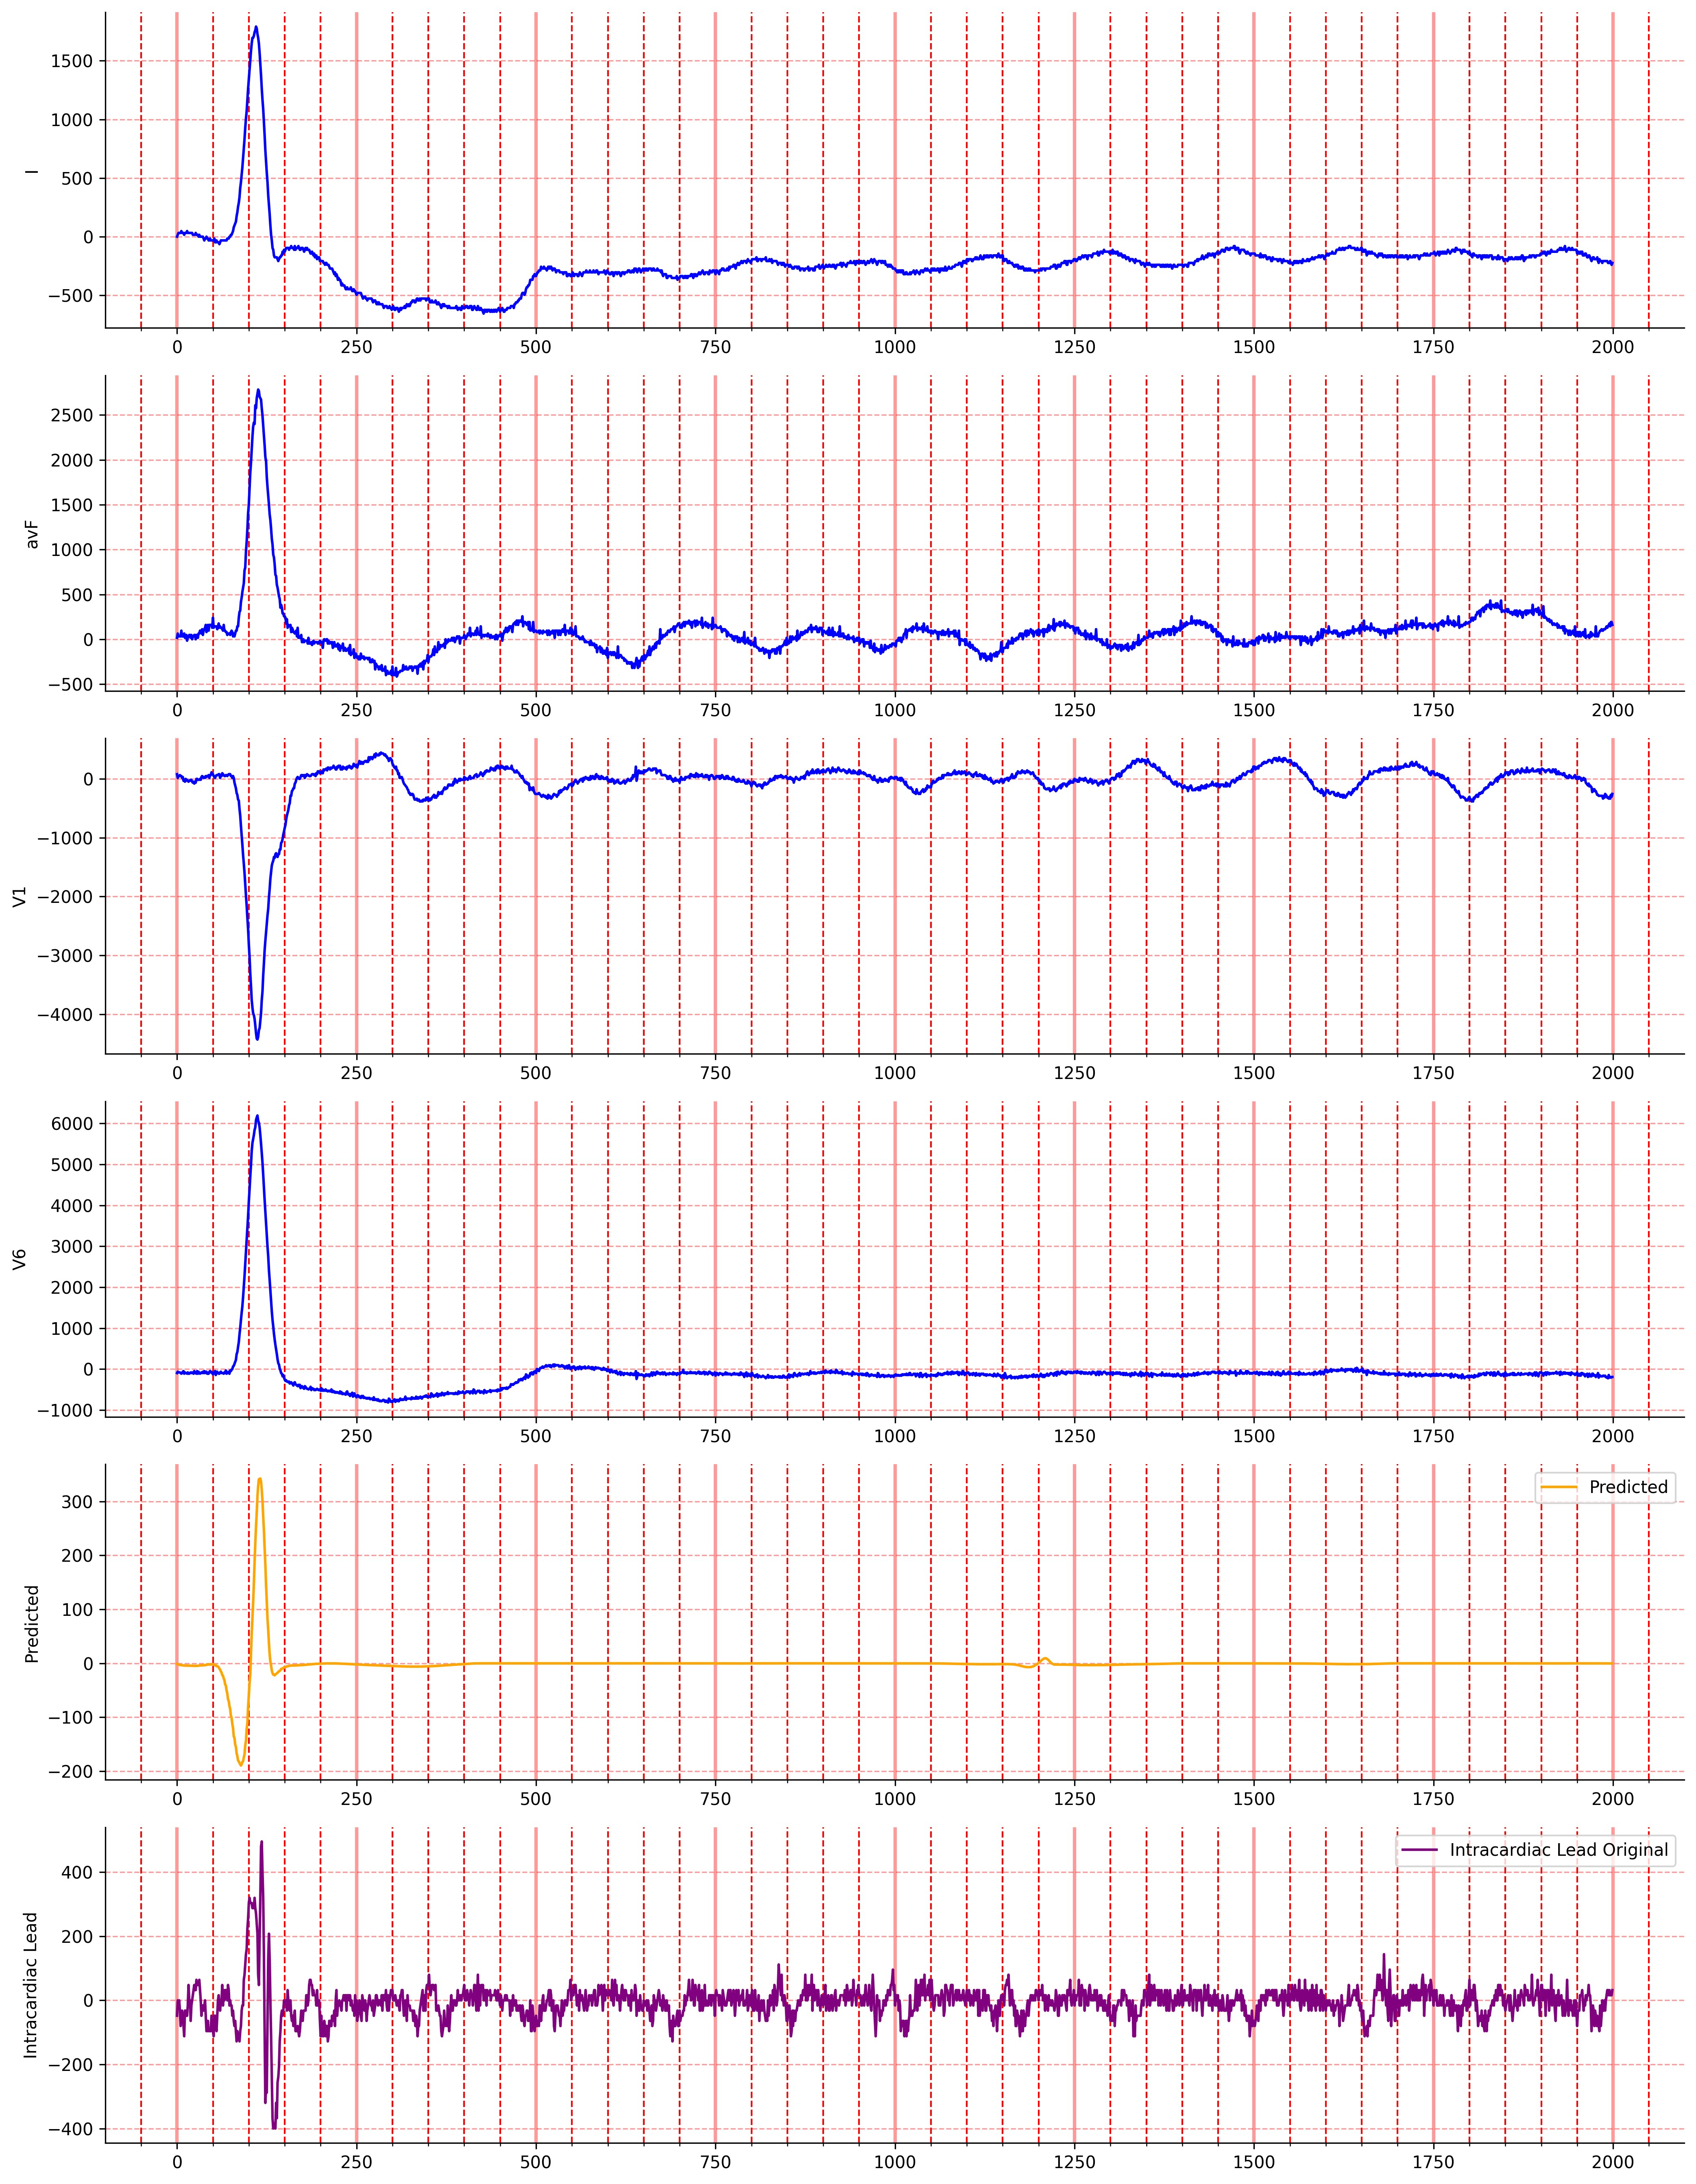
Research question
Can we create AF phenotypes based on the relation between surface ECG and intracardiac rhythm morphologies
Primary objective : Use AI ECG methods (autoencoder ,CNN) to reconstruct the intracardiac rhythm from ECGs and extract relevant features
Secondary objective : Cluster on these features to identify new groups (phenotypes) of patient based on these features

Slide 7

Methods

Slide 8
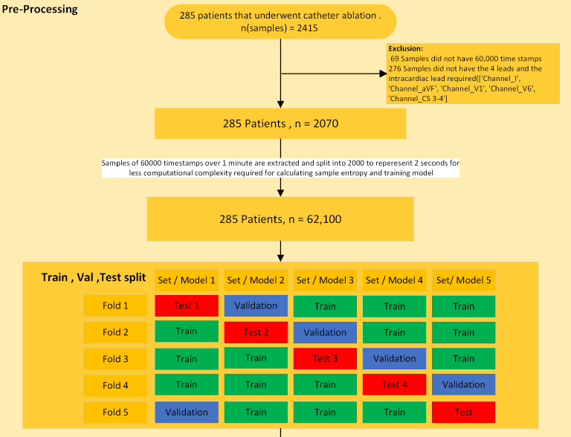
Study Organisation
All patients do not have an equal amount of samples
Samples can be pre/post ablation
Folds roughly split into 5 as to avoid data leakage

Slide 9
Study Approach

Slide 10
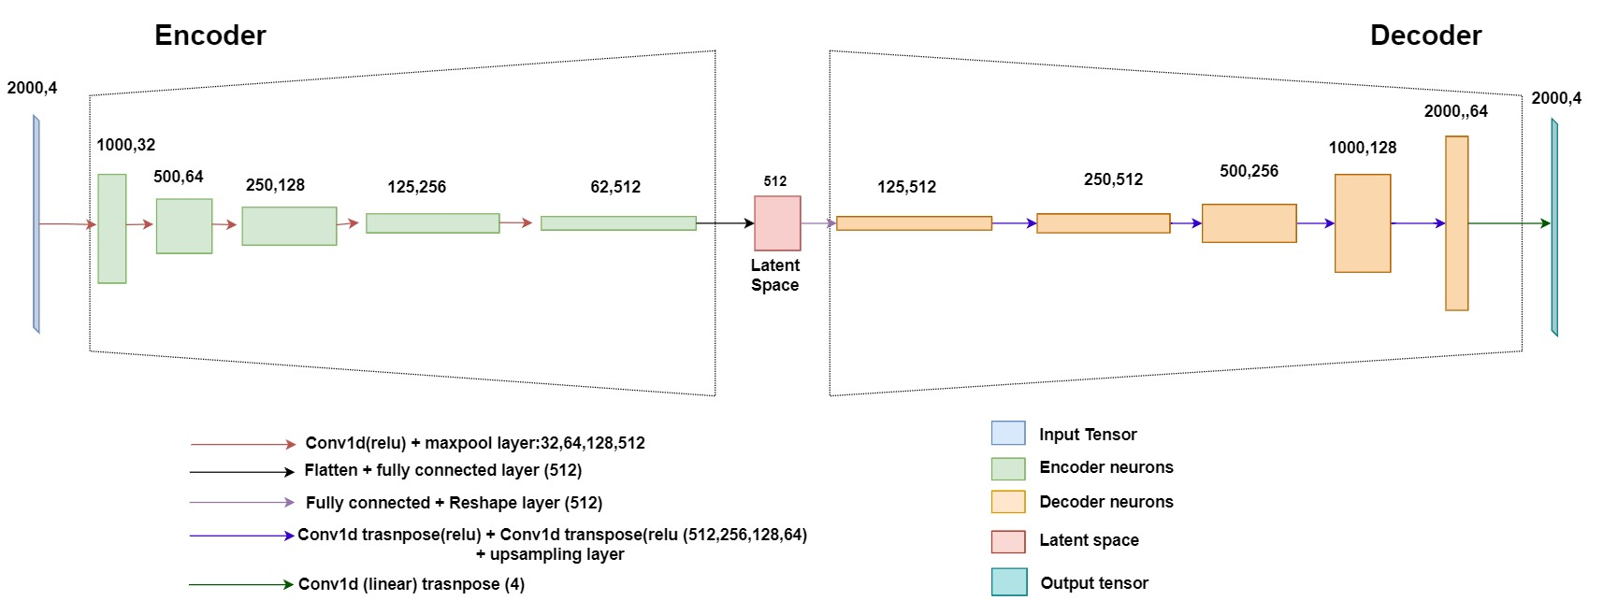
Model (autoencoder)
Latent space representation
ECG
Intracardiac rhythm
Model evaluated on mean absolute error
Notes:
This model representation is made by me and takes inspiration from : Leung, K. (2022) How to Easily Draw Neural Network Architecture Diagrams, Medium. Available at: https://towardsdatascience.com/how-to-easily-draw-neural-network-architecture-diagrams-a6b6138ed875 (Accessed: 13 September 2023).
Kuznetsov, V.V. et al. (2021) ‘Interpretable Feature Generation in ECG Using a Variational Autoencoder’, Frontiers in Genetics, 12, p. 638191. Available at: https://doi.org/10.3389/fgene.2021.638191.

Slide 11
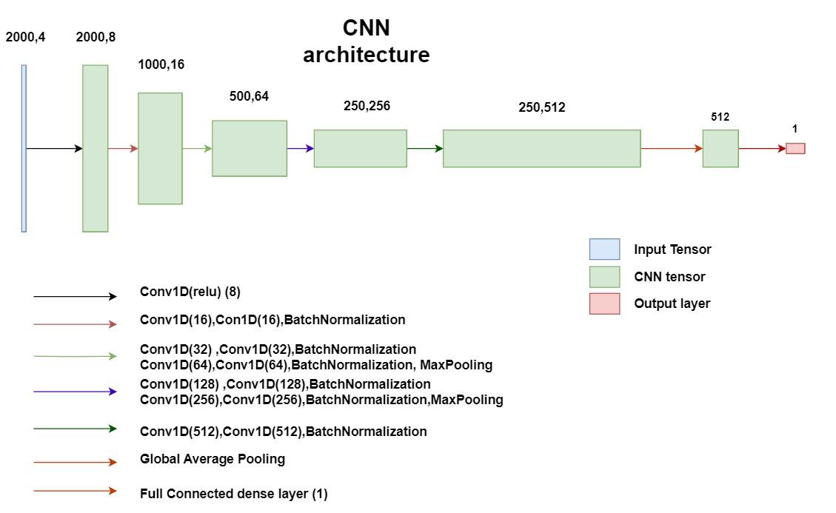
Model CNN
Sample Entropy
M = 2 R= 0.15 * SD
Model evaluated on correlation between original sample entropy values and predicted sample entropy values
Notes:
This model representation is made by me and takes inspiration from : Leung, K. (2022) How to Easily Draw Neural Network Architecture Diagrams, Medium. Available at: https://towardsdatascience.com/how-to-easily-draw-neural-network-architecture-diagrams-a6b6138ed875 (Accessed: 13 September 2023).
Kuznetsov, V.V. et al. (2021) ‘Interpretable Feature Generation in ECG Using a Variational Autoencoder’, Frontiers in Genetics, 12, p. 638191. Available at: https://doi.org/10.3389/fgene.2021.638191.

Slide 12
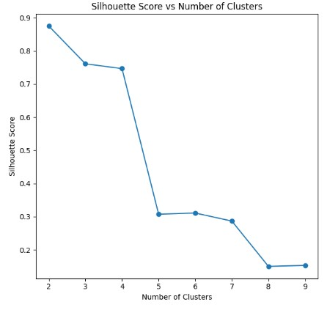
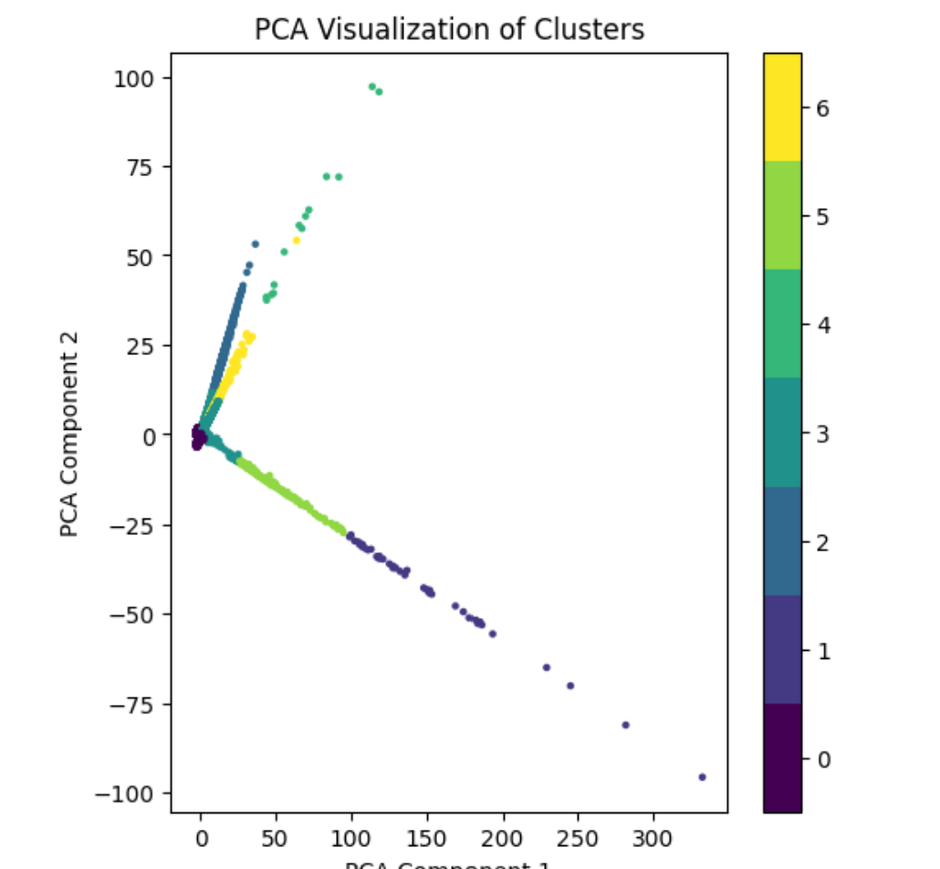
Clustering
Kmeans clustering
Statistical analysis
Continuous variables : Wilcox rank sum test
Categorical : Pearson chi squared , Fischer exact test (smaller cluster)

Slide 13

Results

Slide 14
Primary objective (reconstruction and feature extraction)

Slide 15
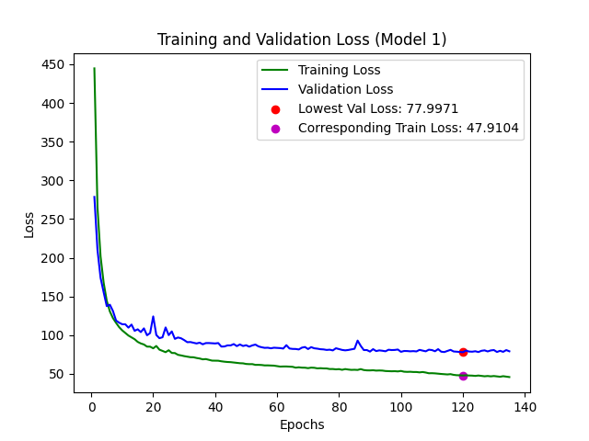
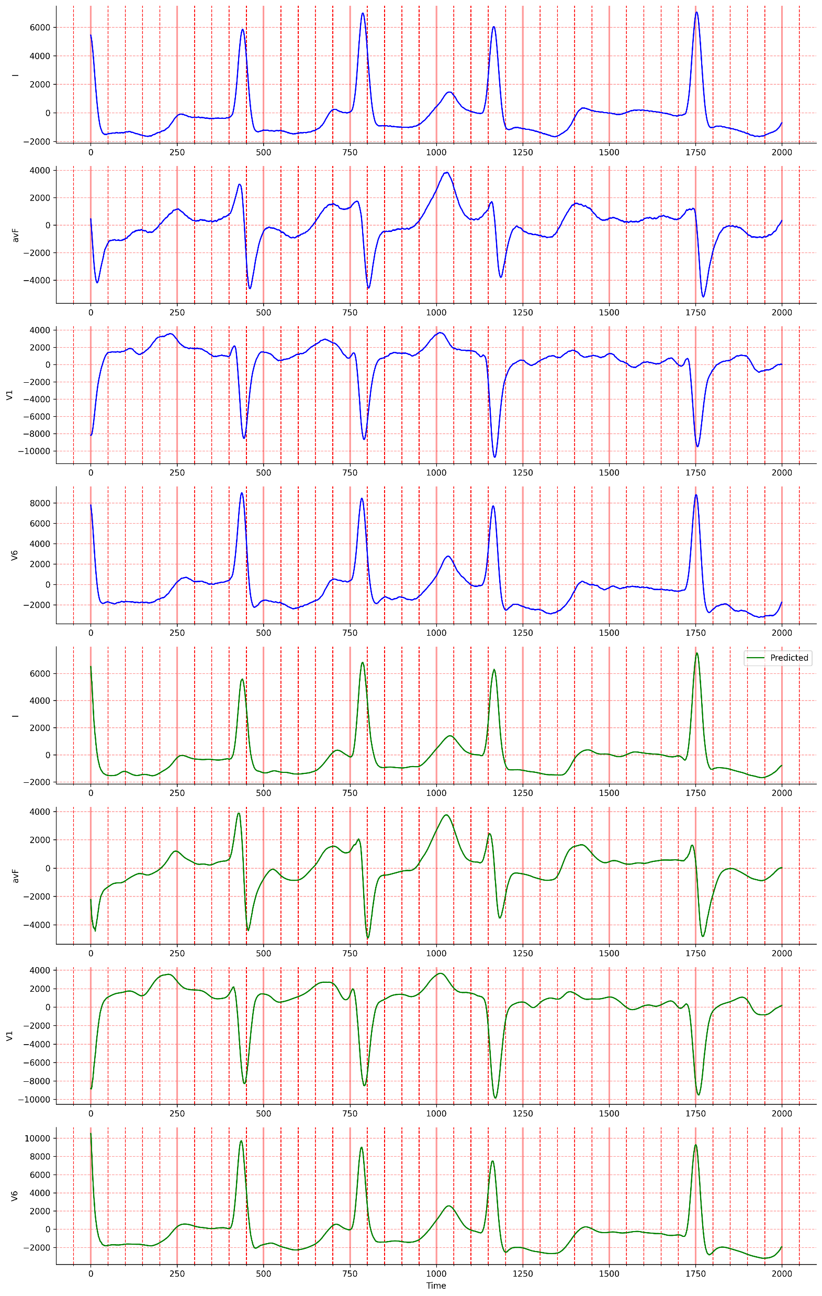
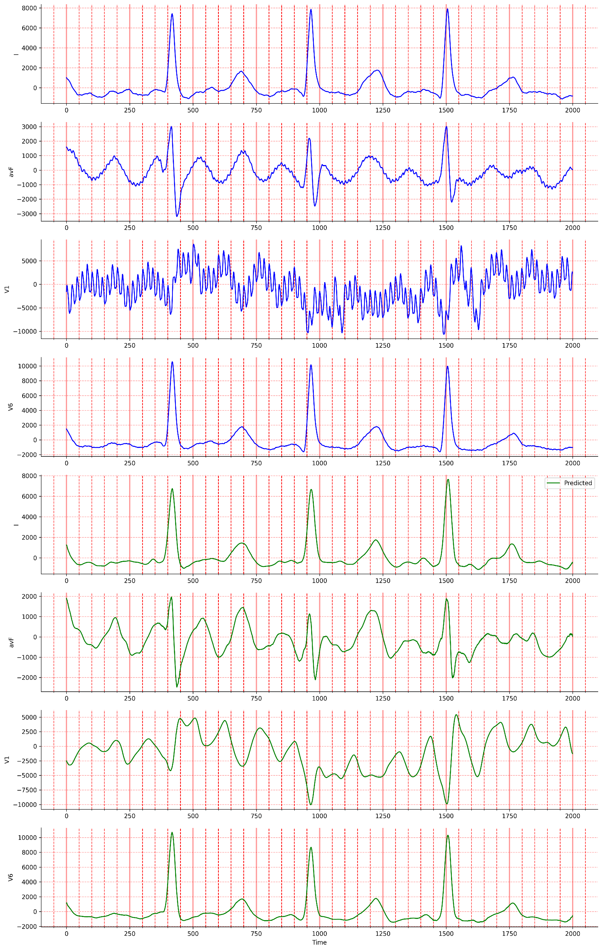
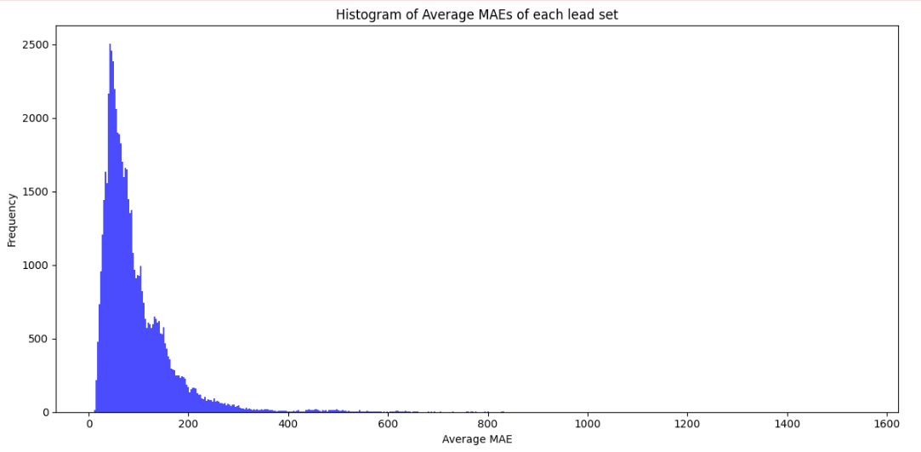
Model appraisal (ECG reconstruction)
Good reconstruction
Bad reconstruction
MAE = 15
MAE = 620
I
original
aVF
V1
V6
I
aVF
Reconstructed
V1
V6

Slide 16
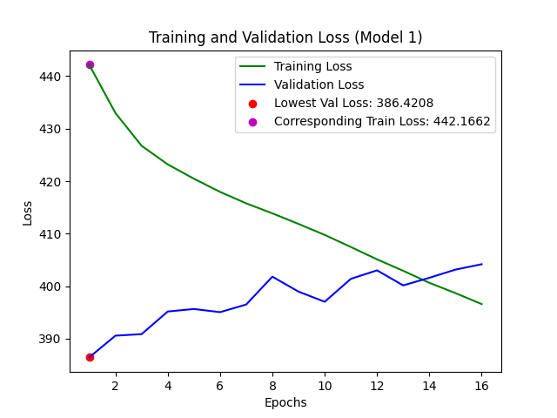
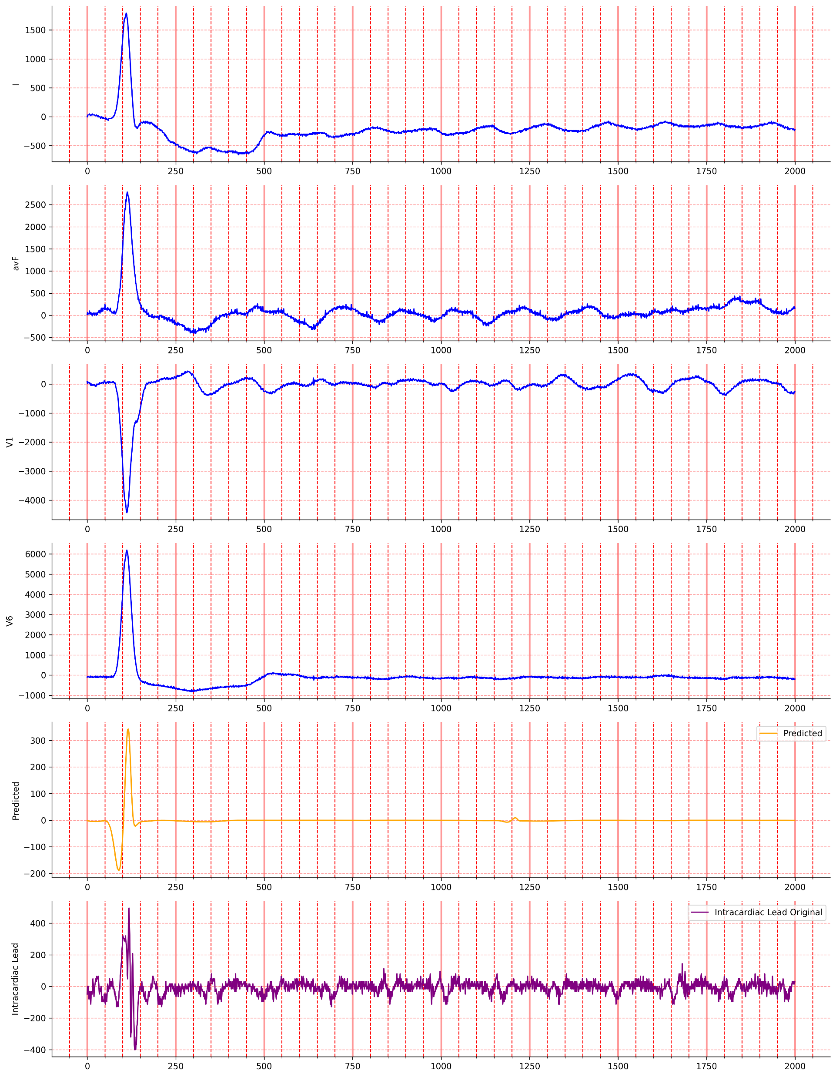
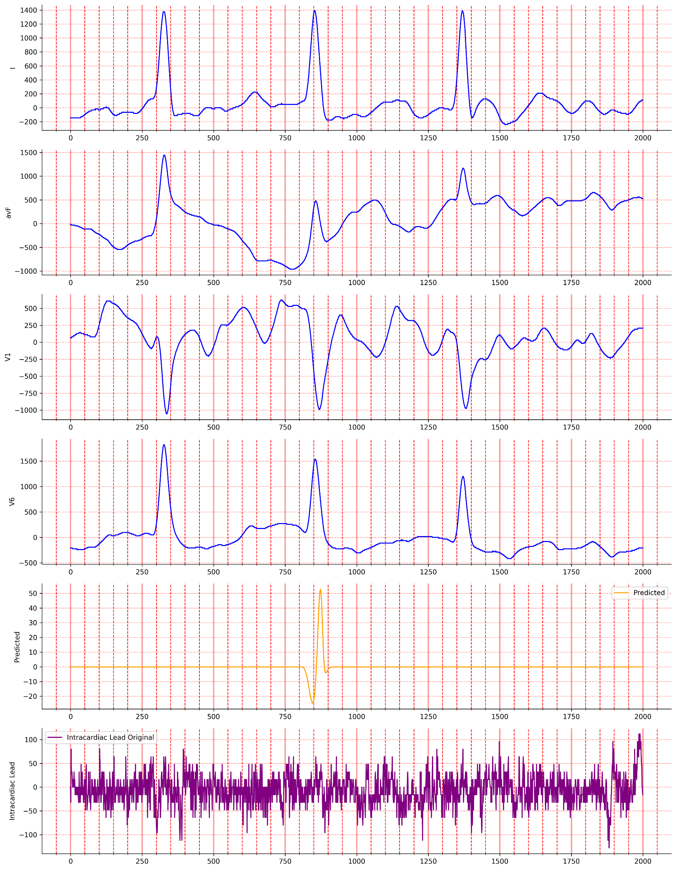
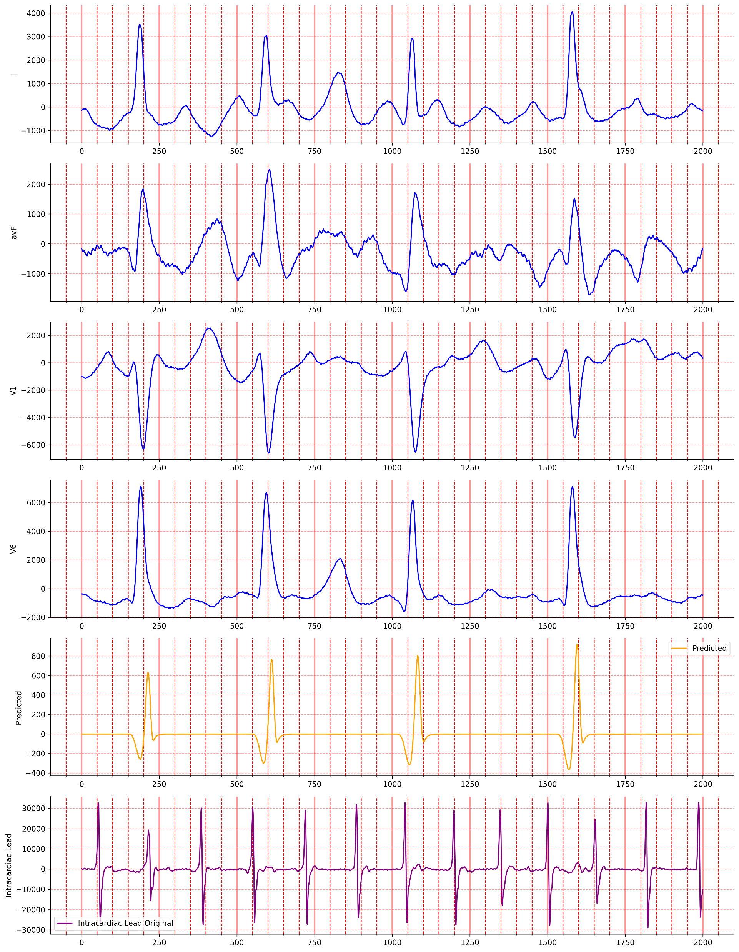
Model appraisal (Intracardiac rhythm)
Good reconstruction
Bad reconstruction
MAE = 25
MAE = 25
MAE = 525
Predicted intracardiac lead
Original intracardiac lead(CS 3-4)

Slide 17
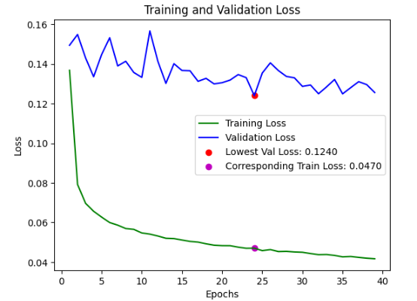
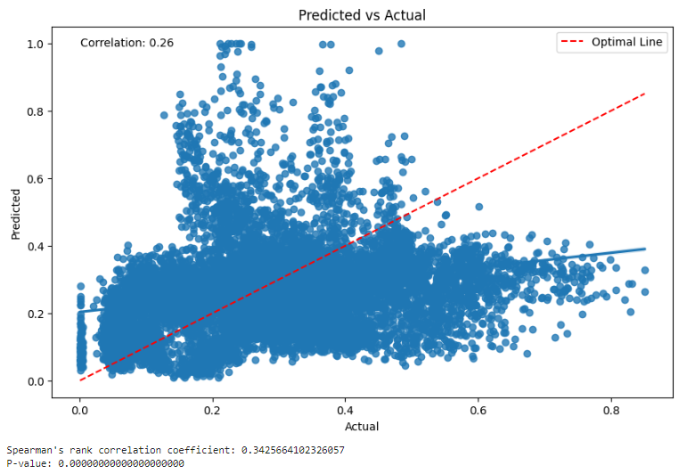
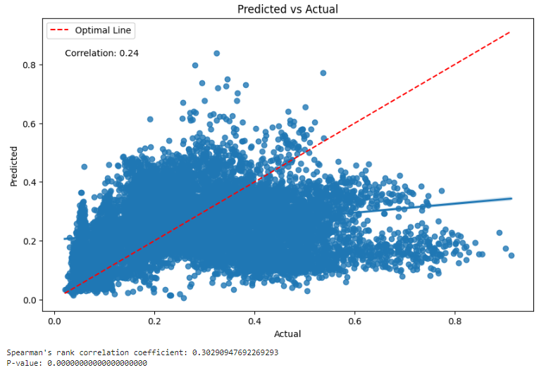
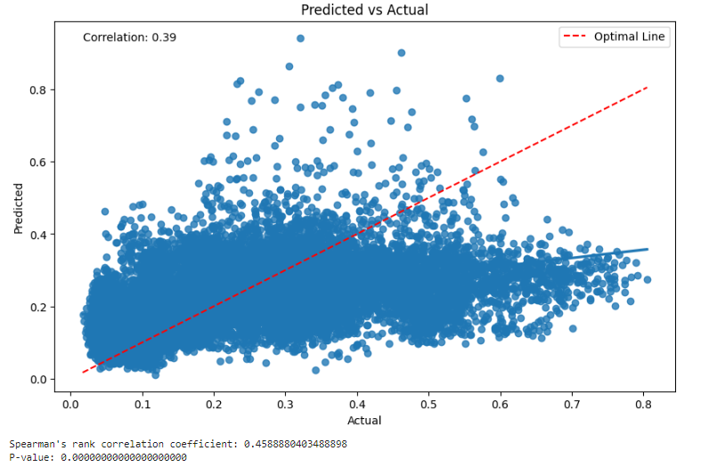
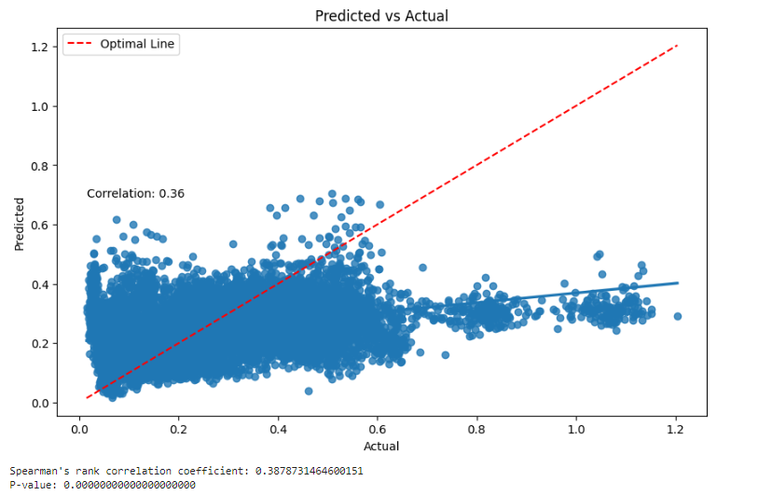
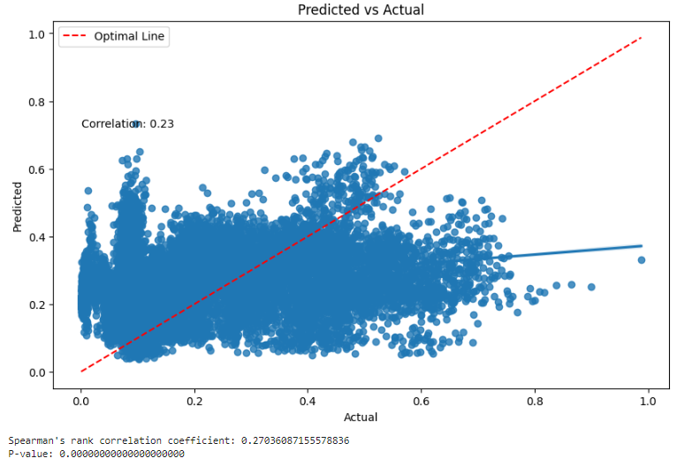
CNN (sample entropy prediction)
Model 2 performance | Model 1 Correlation | Model 2 Correlation
Model 3 Correlation | Model 4 Correlation | Model 5 Correlation

Slide 18
Secondary objective (clustering)

Slide 19
Clustering
Characteristic | Cluster
Cluster Number (number of samples) | 1(n = 42,438) Reference Cluster | 2 (n = 37) | 3(n = 258) | 4 (n= 6,203) | 5 (n = 14) | 6 (n = 107) | 7 (n = 473)
Age(Years) | 63 (9) | 62 (10) | 65 (9) | 63 (9) | 71 (12) | 65 (8) | 65 (11)
BMI | 29.5 (6.3) | 28.6 (3.0) | 26.9 (5.2) | 29.6 (5.7) | 28.7 (2.2) | 28.4(3.2) | 30.0(5.2)
eGFR(less than 100 bad) (mL/min/1.73m2) | 70 (14) | 76(13) | 77 (9) | 69 (14) | 74 (5) | 81 (11) | 68(14)
LA Dimension (mm) | 38.8 (6.1) | 40.8(5.2) | 35.3 (4.9) | 38.9(6.2) | 41.0(4.4) | 38.6 (4.6) | 38.0 (6.0)
LA Area 2Ch (cmsq) | 23.56 (2.75) | 23.03 (1.78) | 22.49 (1.20) | 23.57 (2.49) | 25.29 (2.82) | 22.46 (1.31) | 23.69 (1.87)
LA Area 4Ch (cmsq) | 25.2 (4.0) | 25.3 (3.5) | 23.6 (1.8) | 25.2 (3.8) | 27.1 (6.0) | 23.3(2.9) | 25.1 (2.8)
LVEF (%) 50 good over 50 bad | 51 (7) | 54 (2) | 52 (5) | 50 (7) | 58(6) | 52 (4) | 50 (8)
CHADsVASc | 3.00 (1.38) | 2.08(0.72) | 3.08(0.82) | 3.11 (1.47) | 2.80(0.11) | 2.80 (1.40) | 3.59 (1.54)
CAAPAF | 3.92(1.53) | 4.27(2.71) | 3.77(1.49) | 3.94(1.62) | 4.36(1.45) | 3.92(1.72) | 4.01 (1.73)
APPLE | 2.04 (0.90) | 2.03 (0.83) | 1.71 (0.58) | 2.14 (0.94) | 1.93(0.41) | 1.79(0.70) | 2.37 (1.02)
Atrial Diameter(cm) | 1.63 (0.97) | 1.84 (0.93) | 1.23 (0.45) | 1.67 (0.98) | 1.95(0.58) | 1.37(0.75) | 1.58 (0.84)
sample entropy | 0.27 (0.18) | 0.20(0.08) | 0.21(0.10) | 0.26(0.16) | 0.65(0.18) | 0.13(0.09) | 0.29 (0.17)
Notes:
This table shows the clusters and the corresponding characteristics of each cluster :
Highlighted in yellow are means that represent distribution that are statistical different from cluster 1
BMI the higher the more detrimental to health
eGFR is globular filtration rate and represents kidney function the lower the worse the best is 100
LA dimension : Is the size of the left atrium in mm
LA area 2CH and 4CH and used to depict left atrium volume the larger they are the worse it is
LVEF : left ventricular ejection fraction 50 or under is good over 50 is bad
CHADSVASC is a cvd risk score the greater it is the worse
APPLE : another risk score to estimate chance of AF recurrence the greater it is the worse
CAAPAF another risk score the greater the worse
The rest is self explanatory

Slide 20
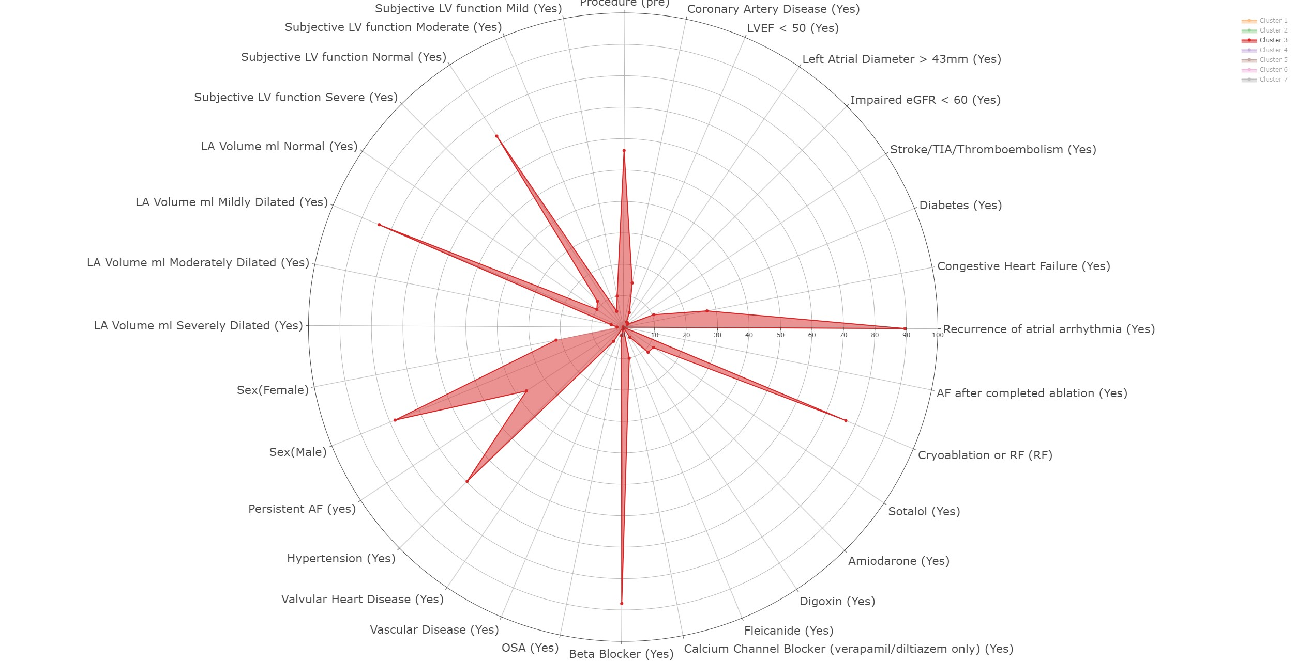
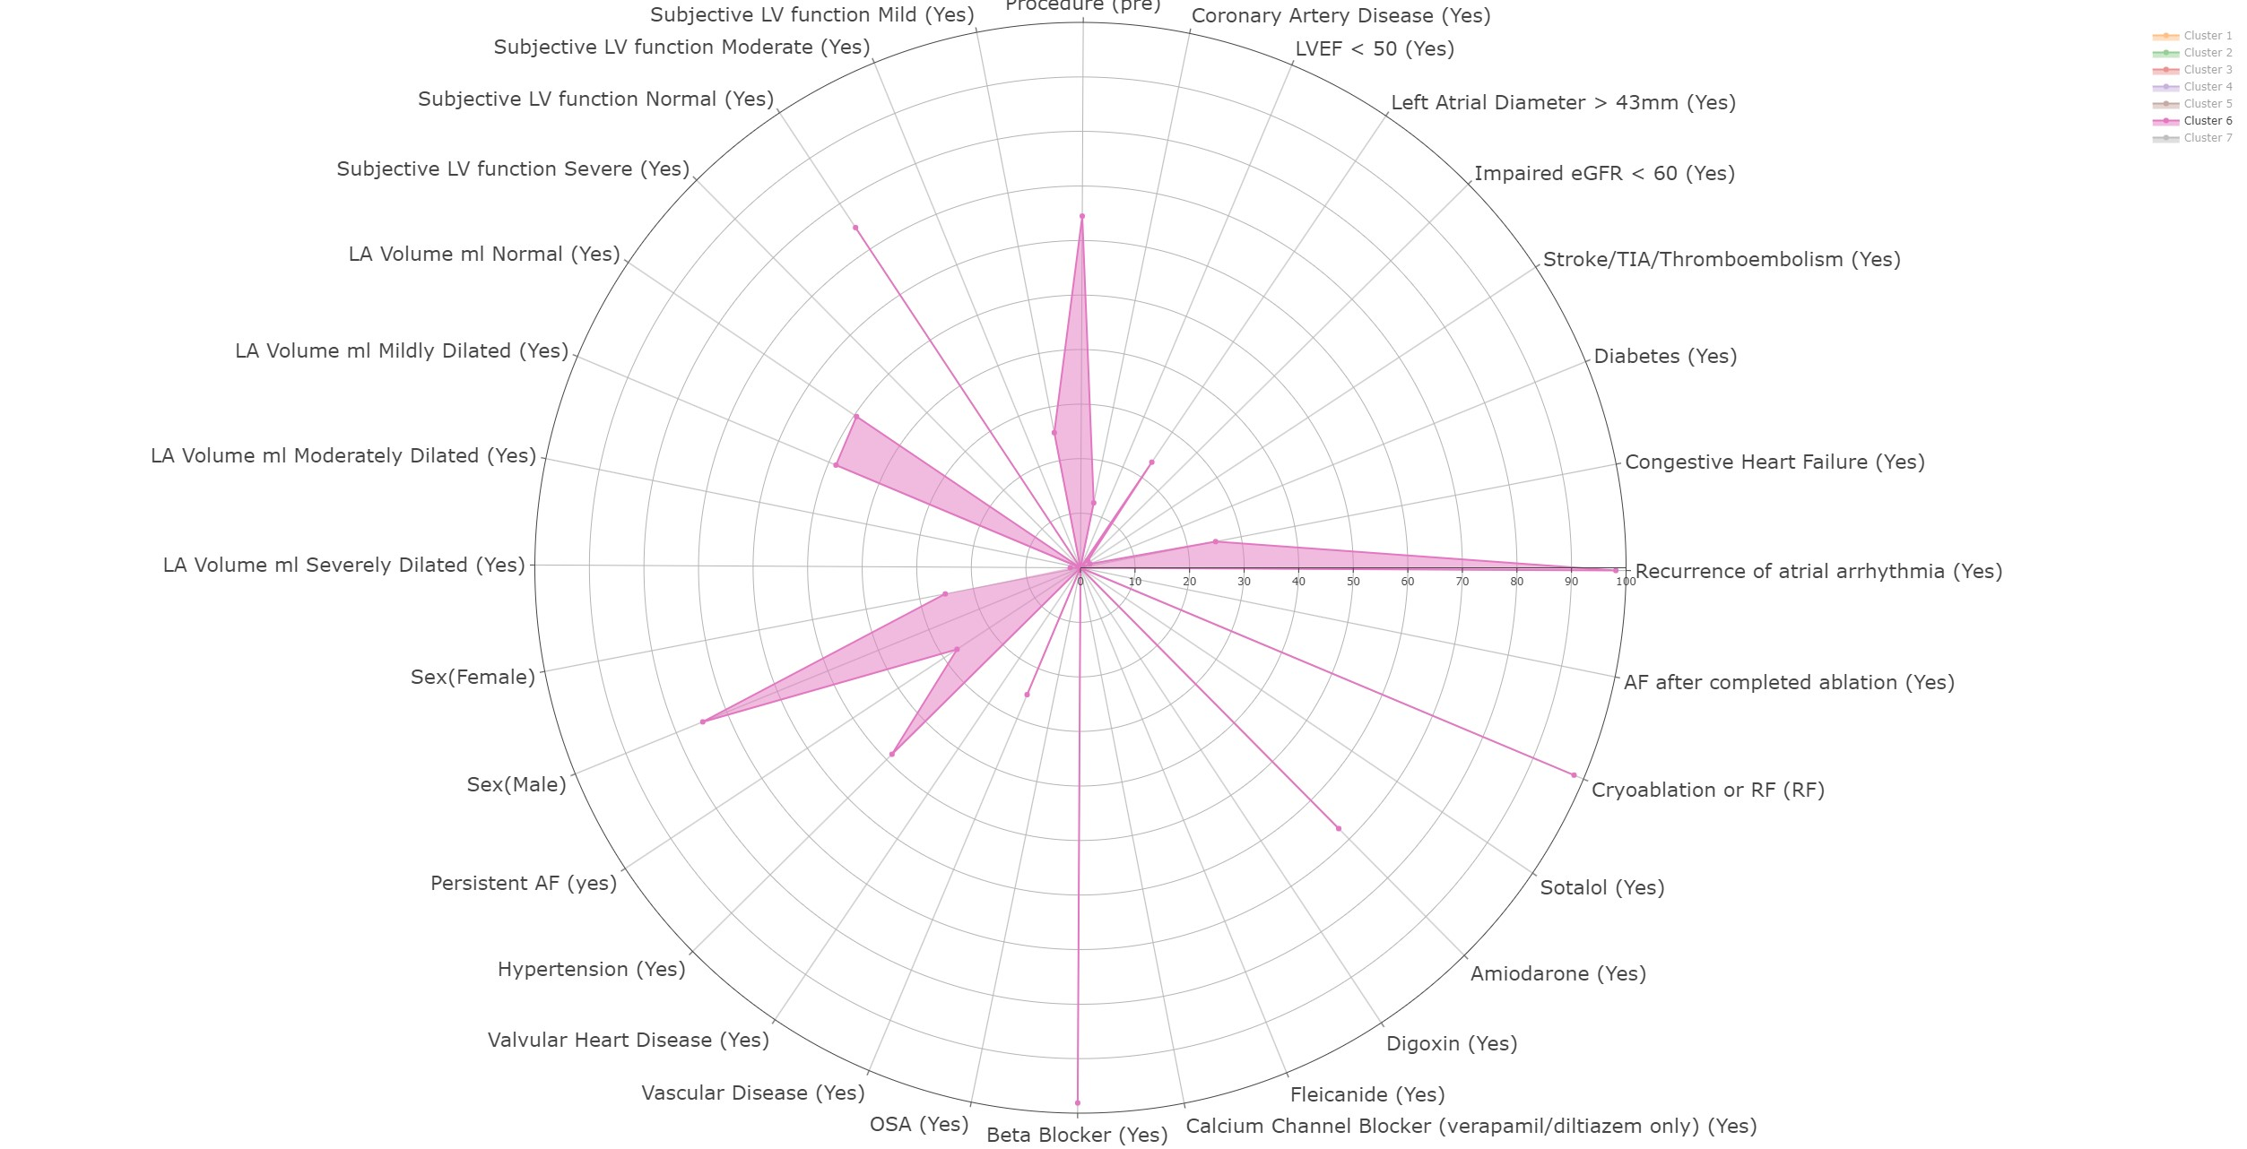
Low sample entropy cohorts
Cluster 3 SE=0.21
Cluster 3 has lowest proportion of people with an enlarged atrial diameter (1.9%)
They do not have other comorbidities at high rate valvular, vascular disease (5.4% and 0%)
Cluster 6 SE = 0.13
Cluster 6 has the Highest level of normal LA volume at 50%
Notes:
These radar plot the proportion of yes to each characteristic labelled here :
eGFR is globular filtration rate and represents kidney function the lower the worse the best is 100
LVEF under 50 is good and reduces risk
Persistent AF as opposed to longstanding AF is recorded here too
SE is representative of the Sample entropy

Slide 21
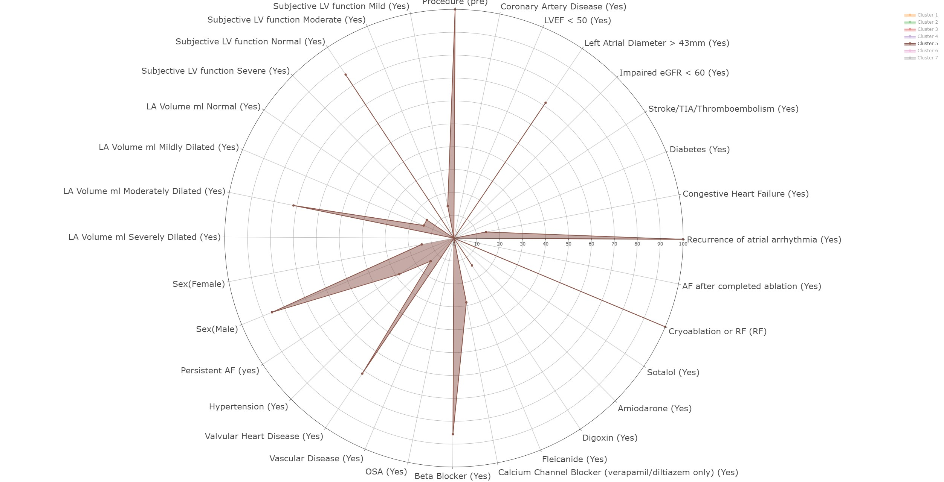
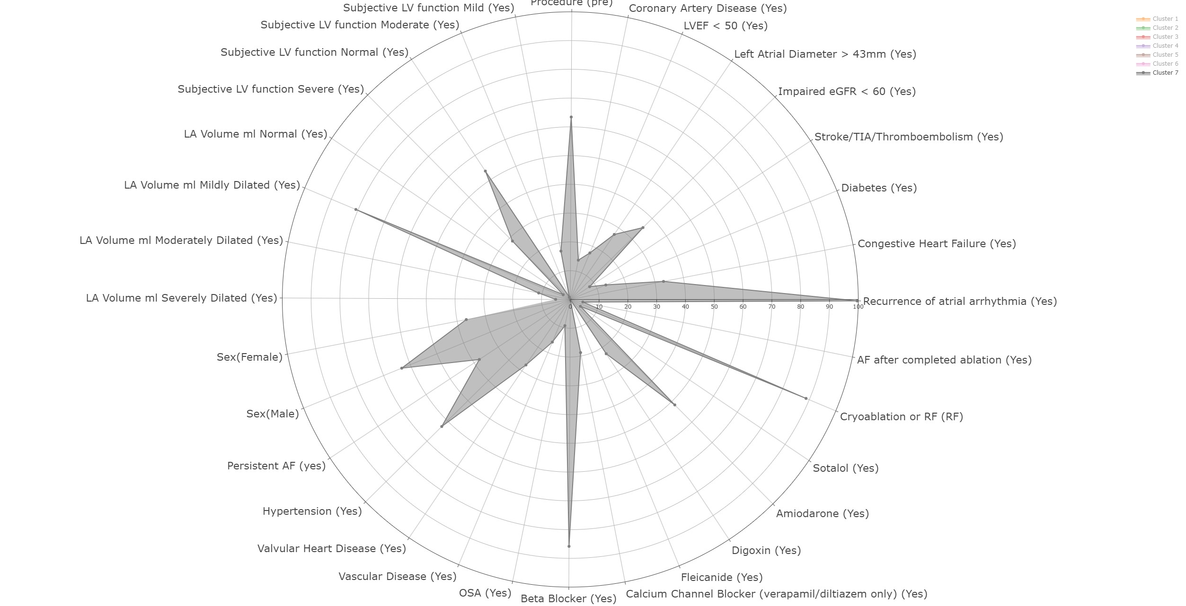
High sample entropy cohorts
Cluster 5 SE = 0.65
Cluster 5 highest proportion of enlarged left atrial diameter (71%)
Valvular heart disease also high at 75%
Cluster 7 SE = 0.29
Cluster 7 has highest rate of severe left ventricle function (29%)
Highest rate of impaired egfr/kidney function 36%
Notes:
These radar plot the proportion of yes to each characteristic labelled here :
eGFR is globular filtration rate and represents kidney function the lower the worse the best is 100
LVEF under 50 is good and reduces risk
Persistent AF as opposed to longstanding AF is recorded here too
SE is representative of the Sample entropy

Slide 22

Discussion

Slide 23
Phenotype Analysis
Have we identified new phenotypes ?:
Clinically relevant phenotypes based on intracardiac morphology non-invasively
4 phenotypes (2 low risk ,2 high risk)
Model performance a concern
Clustering assumptions is a concern
Is this solution practical:
We first need to research what treatments differentiate these clusters ₁₂
Failure to recreate intracardiac rhythm signal shows lack of promise
Notes:
Solatol research mentioned from this point in presentation is from : Southworth, M.R. et al. (1999) ‘Comparison of sotalol versus quinidine for maintenance of normal sinus rhythm in patients with chronic atrial fibrillation’, The American Journal of Cardiology, 83(12), pp. 1629–1632. Available at: https://doi.org/10.1016/s0002-9149(99)00168-x.

Slide 24
Data and model methodology (limitations)
Data:
Only able to cluster on 196 patients making it difficult to perform a per patient analysis
Model methodology:
Difficulties also arises from feature extraction , less feature meant worse predictive performance
MAE not the best loss function , could have used pearson correlation coefficient
Preprocessing may be required to deal with more noisy data like using the Butterworth filter

Slide 25
Future work
Data is difficult to gather
Look to developing methods like variational autoencoder₁₃
Limit scope and focus on cardiac cycles
Previous research looks at intracardiac cycles and while performance was better generalisability did see a dip ₁₄
Notes:
13. An example how how VAE have been used to generate interpretable ECG reading is seen in this study: Kuznetsov, V.V. et al. (2021) ‘Interpretable Feature Generation in ECG Using a Variational Autoencoder’, Frontiers in Genetics, 12, p. 638191. Available at: https://doi.org/10.3389/fgene.2021.638191.
14. A similar process to these study has been used by these researchers on 14 patients and only reconstructing the cardiac cycles : Banta, A. et al. (2021) ‘A Novel Convolutional Neural Network for Reconstructing Surface Electrocardiograms from Intracardiac Electrograms and Vice Versa’, Artificial intelligence in medicine, 118, p. 102135. Available at: https://doi.org/10.1016/j.artmed.2021.102135.

Slide 26
Thank you

Slide 27
Appendix (categorical variables table)
Characteristic | Cluster
 | 1 | 2 | 3 | 4 | 5 | 6 | 7
Sex MF
Female | 26% | 0% | 22% | 23% | 14% | 25% | 37%
Male | 74% | 100% | 78% | 77% | 86% | 75% | 63%
Persistent or longstanding persistent 1 year
Longstanding | 72% | 100% | 63% | 71% | 71% | 73% | 62%
Persistent | 28% | 0% | 37% | 29% | 29% | 27% | 38%
Hypertension (yes) | 52% | 59% | 70% | 50% | 14% | 49% | 63%
Diabetes (yes) | 9.8% | 0% | 10% | 12% | 0% | 1.9% | 13%
Coronary Disease (yes) | 16% | 30% | 14% | 16% | 0% | 12% | 14%
Valvular Heart Disease (yes) | 18% | 0% | 5.4% | 18% | 71% | 0% | 27%
Vascular disease (yes) | 6.3% | 0% | 0% | 8.6% | 0% | 25% | 16%
StrokeThromboembolism(yes) | 11% | 0% | 1.6% | 13% | 0% | 0% | 8.0%
OSA (yes) | 4.3% | 0% | 2.7% | 4.1% | 0% | 0% | 9.3%
Heart Failure (yes) | 31% | 0% | 27% | 35% | 14% | 25% | 33%
Beta Blocker Not including sotalol (yes) | 83% | 100% | 88% | 84% | 86% | 98% | 86%
Calcium Channel Blocker YN verapamildiltiazem only | 17% | 0% | 10% | 17% | 29% | 0% | 19%
Fleicanide (yes) | 1.5% | 0% | 0% | 2.1% | 0% | 0% | 0%
Digoxin (yes) | 17% | 0% | 3.9% | 16% | 14% | 0% | 23%
Amiodarone (yes) | 30% | 19% | 11% | 29% | 0% | 67% | 52%
Sotalol (yes) | 3.9% | 0% | 12% | 3.2% | 0% | 0% | 4.2%
Cryoablation or RF
Cryoablation | 9.4% | 0% | 23% | 9.5% | 0% | 1.9% | 11%
RF | 91% | 100% | 77% | 90% | 100% | 98% | 89%
Was this patient in AF after completed ablation (Yes) | 7.7% | 0% | 0% | 7.1% | 0% | 0% | 4.4%
Recurrence of atrial arrhythmia (yes) | 92% | 100% | 90% | 92% | 100% | 98% | 100%
Congestive Heart Failure (yes) | 31% | 0% | 27% | 34% | 14% | 25% | 33%
Diabetes (yes) | 9.8% | 0% | 10% | 12% | 0% | 1.9% | 13%
imPaired eGFR <60 (yes) | 18% | 2.7% | 1.9% | 22% | 0% | 1.9% | 36%
Left Atrial Diameter <43mm | 27% | 51% | 1.9% | 28% | 71% | 23% | 27%
LVEF >50 | 16% | 0% | 5.0% | 17% | 0% | 0% | 18%
Coronary Artery Disease | 16% | 30% | 14% | 16% | 0% | 12% | 14%
Subjective LV function (Mild) | 9.3% | 0% | 10% | 12% | 14% | 25% | 17%
Subjective LV function (Moderate) | 13% | 0% | 5.4% | 18% | 0% | 0% | 0.8%
Subjective LV function (Normal) | 67% | 100% | 73% | 58% | 86% | 75% | 53%
Subjective LV function (Severe) | 10% | 0% | 12% | 12% | 0% | 0% | 29%
procedure
post | 44% | 30% | 44% | 48% | 0% | 36% | 37%
pre | 56% | 70% | 56% | 52% | 100% | 64% | 63%
LA Volume ml (normal) | 11% | 49% | 10% | 9.3% | 14% | 50% | 3.0%
LA Volume ml (mildly dilated) | 58% | 49% | 84% | 61% | 14% | 49% | 81%
LA Volume ml (moderately dilated) | 18% | 0% | 3.9% | 17% | 71% | 0% | 11%
LA Volume ml (severely dilated) | 12% | 2.7% | 1.9% | 12% | 0% | 1.9% | 5.1%

Slide 28
Appendix (categorical variables table)
Characteristic | Cluster
 | 1 | 2 | 3 | 4 | 5 | 6 | 7
Hypertension (yes) | 52% | 59% | 70% | 50% | 14% | 49% | 63%
Diabetes (yes) | 9.8% | 0% | 10% | 12% | 0% | 1.9% | 13%
Coronary Disease (yes) | 16% | 30% | 14% | 16% | 0% | 12% | 14%
Valvular Heart Disease (yes) | 18% | 0% | 5.4% | 18% | 71% | 0% | 27%
Vascular disease (yes) | 6.3% | 0% | 0% | 8.6% | 0% | 25% | 16%
StrokeThromboembolism(yes) | 11% | 0% | 1.6% | 13% | 0% | 0% | 8.0%
OSA (yes) | 4.3% | 0% | 2.7% | 4.1% | 0% | 0% | 9.3%
Heart Failure (yes) | 31% | 0% | 27% | 35% | 14% | 25% | 33%
Beta Blocker Not including sotalol (yes) | 83% | 100% | 88% | 84% | 86% | 98% | 86%
Calcium Channel Blocker YN verapamildiltiazem only | 17% | 0% | 10% | 17% | 29% | 0% | 19%
Fleicanide (yes) | 1.5% | 0% | 0% | 2.1% | 0% | 0% | 0%
Digoxin (yes) | 17% | 0% | 3.9% | 16% | 14% | 0% | 23%
Amiodarone (yes) | 30% | 19% | 11% | 29% | 0% | 67% | 52%
Sotalol (yes) | 3.9% | 0% | 12% | 3.2% | 0% | 0% | 4.2%
Cryoablation or RF
Cryoablation | 9.4% | 0% | 23% | 9.5% | 0% | 1.9% | 11%
RF | 91% | 100% | 77% | 90% | 100% | 98% | 89%
Was this patient in AF after completed ablation (Yes) | 7.7% | 0% | 0% | 7.1% | 0% | 0% | 4.4%
Recurrence of atrial arrhythmia (yes) | 92% | 100% | 90% | 92% | 100% | 98% | 100%
Congestive Heart Failure (yes) | 31% | 0% | 27% | 34% | 14% | 25% | 33%
Diabetes (yes) | 9.8% | 0% | 10% | 12% | 0% | 1.9% | 13%
imPaired eGFR <60 (yes) | 18% | 2.7% | 1.9% | 22% | 0% | 1.9% | 36%
Left Atrial Diameter <43mm | 27% | 51% | 1.9% | 28% | 71% | 23% | 27%
LVEF >50 | 16% | 0% | 5.0% | 17% | 0% | 0% | 18%
Coronary Artery Disease | 16% | 30% | 14% | 16% | 0% | 12% | 14%
Subjective LV function (Mild) | 9.3% | 0% | 10% | 12% | 14% | 25% | 17%
Subjective LV function (Moderate) | 13% | 0% | 5.4% | 18% | 0% | 0% | 0.8%
Subjective LV function (Normal) | 67% | 100% | 73% | 58% | 86% | 75% | 53%
Subjective LV function (Severe) | 10% | 0% | 12% | 12% | 0% | 0% | 29%
procedure
post | 44% | 30% | 44% | 48% | 0% | 36% | 37%
pre | 56% | 70% | 56% | 52% | 100% | 64% | 63%
LA Volume ml (normal) | 11% | 49% | 10% | 9.3% | 14% | 50% | 3.0%
LA Volume ml (mildly dilated) | 58% | 49% | 84% | 61% | 14% | 49% | 81%
LA Volume ml (moderately dilated) | 18% | 0% | 3.9% | 17% | 71% | 0% | 11%
LA Volume ml (severely dilated) | 12% | 2.7% | 1.9% | 12% | 0% | 1.9% | 5.1%

Slide 29
Appendix (categorical variables table)
Characteristic | Cluster
 | 1 | 2 | 3 | 4 | 5 | 6 | 7
StrokeThromboembolism(yes) | 11% | 0% | 1.6% | 13% | 0% | 0% | 8.0%
OSA (yes) | 4.3% | 0% | 2.7% | 4.1% | 0% | 0% | 9.3%
Heart Failure (yes) | 31% | 0% | 27% | 35% | 14% | 25% | 33%
Beta Blocker Not including sotalol (yes) | 83% | 100% | 88% | 84% | 86% | 98% | 86%
Calcium Channel Blocker YN verapamildiltiazem only | 17% | 0% | 10% | 17% | 29% | 0% | 19%
Fleicanide (yes) | 1.5% | 0% | 0% | 2.1% | 0% | 0% | 0%
Digoxin (yes) | 17% | 0% | 3.9% | 16% | 14% | 0% | 23%
Amiodarone (yes) | 30% | 19% | 11% | 29% | 0% | 67% | 52%
Sotalol (yes) | 3.9% | 0% | 12% | 3.2% | 0% | 0% | 4.2%
Cryoablation or RF
Cryoablation | 9.4% | 0% | 23% | 9.5% | 0% | 1.9% | 11%
RF | 91% | 100% | 77% | 90% | 100% | 98% | 89%
Was this patient in AF after completed ablation (Yes) | 7.7% | 0% | 0% | 7.1% | 0% | 0% | 4.4%
Recurrence of atrial arrhythmia (yes) | 92% | 100% | 90% | 92% | 100% | 98% | 100%
Congestive Heart Failure (yes) | 31% | 0% | 27% | 34% | 14% | 25% | 33%
Diabetes (yes) | 9.8% | 0% | 10% | 12% | 0% | 1.9% | 13%
imPaired eGFR <60 (yes) | 18% | 2.7% | 1.9% | 22% | 0% | 1.9% | 36%
Left Atrial Diameter <43mm | 27% | 51% | 1.9% | 28% | 71% | 23% | 27%
LVEF >50 | 16% | 0% | 5.0% | 17% | 0% | 0% | 18%
Coronary Artery Disease | 16% | 30% | 14% | 16% | 0% | 12% | 14%
Subjective LV function (Mild) | 9.3% | 0% | 10% | 12% | 14% | 25% | 17%
Subjective LV function (Moderate) | 13% | 0% | 5.4% | 18% | 0% | 0% | 0.8%
Subjective LV function (Normal) | 67% | 100% | 73% | 58% | 86% | 75% | 53%
Subjective LV function (Severe) | 10% | 0% | 12% | 12% | 0% | 0% | 29%
procedure
post | 44% | 30% | 44% | 48% | 0% | 36% | 37%
pre | 56% | 70% | 56% | 52% | 100% | 64% | 63%
LA Volume ml (normal) | 11% | 49% | 10% | 9.3% | 14% | 50% | 3.0%
LA Volume ml (mildly dilated) | 58% | 49% | 84% | 61% | 14% | 49% | 81%
LA Volume ml (moderately dilated) | 18% | 0% | 3.9% | 17% | 71% | 0% | 11%
LA Volume ml (severely dilated) | 12% | 2.7% | 1.9% | 12% | 0% | 1.9% | 5.1%

Slide 30
Appendix (categorical variables table)
Characteristic | Cluster
 | 1 | 2 | 3 | 4 | 5 | 6 | 7
Calcium Channel Blocker YN verapamildiltiazem only | 17% | 0% | 10% | 17% | 29% | 0% | 19%
Fleicanide (yes) | 1.5% | 0% | 0% | 2.1% | 0% | 0% | 0%
Digoxin (yes) | 17% | 0% | 3.9% | 16% | 14% | 0% | 23%
Amiodarone (yes) | 30% | 19% | 11% | 29% | 0% | 67% | 52%
Sotalol (yes) | 3.9% | 0% | 12% | 3.2% | 0% | 0% | 4.2%
Cryoablation or RF
Cryoablation | 9.4% | 0% | 23% | 9.5% | 0% | 1.9% | 11%
RF | 91% | 100% | 77% | 90% | 100% | 98% | 89%
Was this patient in AF after completed ablation (Yes) | 7.7% | 0% | 0% | 7.1% | 0% | 0% | 4.4%
Recurrence of atrial arrhythmia (yes) | 92% | 100% | 90% | 92% | 100% | 98% | 100%
Congestive Heart Failure (yes) | 31% | 0% | 27% | 34% | 14% | 25% | 33%
Diabetes (yes) | 9.8% | 0% | 10% | 12% | 0% | 1.9% | 13%
imPaired eGFR <60 (yes) | 18% | 2.7% | 1.9% | 22% | 0% | 1.9% | 36%
Left Atrial Diameter <43mm | 27% | 51% | 1.9% | 28% | 71% | 23% | 27%
LVEF >50 | 16% | 0% | 5.0% | 17% | 0% | 0% | 18%
Coronary Artery Disease | 16% | 30% | 14% | 16% | 0% | 12% | 14%
Subjective LV function (Mild) | 9.3% | 0% | 10% | 12% | 14% | 25% | 17%
Subjective LV function (Moderate) | 13% | 0% | 5.4% | 18% | 0% | 0% | 0.8%
Subjective LV function (Normal) | 67% | 100% | 73% | 58% | 86% | 75% | 53%
Subjective LV function (Severe) | 10% | 0% | 12% | 12% | 0% | 0% | 29%
procedure
post | 44% | 30% | 44% | 48% | 0% | 36% | 37%
pre | 56% | 70% | 56% | 52% | 100% | 64% | 63%
LA Volume ml (normal) | 11% | 49% | 10% | 9.3% | 14% | 50% | 3.0%
LA Volume ml (mildly dilated) | 58% | 49% | 84% | 61% | 14% | 49% | 81%
LA Volume ml (moderately dilated) | 18% | 0% | 3.9% | 17% | 71% | 0% | 11%
LA Volume ml (severely dilated) | 12% | 2.7% | 1.9% | 12% | 0% | 1.9% | 5.1%

Slide 31
Appendix (categorical variables table)
Characteristic | Cluster
 | 1 | 2 | 3 | 4 | 5 | 6 | 7
Cryoablation or RF
Cryoablation | 9.4% | 0% | 23% | 9.5% | 0% | 1.9% | 11%
RF | 91% | 100% | 77% | 90% | 100% | 98% | 89%
Was this patient in AF after completed ablation (Yes) | 7.7% | 0% | 0% | 7.1% | 0% | 0% | 4.4%
Recurrence of atrial arrhythmia (yes) | 92% | 100% | 90% | 92% | 100% | 98% | 100%
Congestive Heart Failure (yes) | 31% | 0% | 27% | 34% | 14% | 25% | 33%
Diabetes (yes) | 9.8% | 0% | 10% | 12% | 0% | 1.9% | 13%
imPaired eGFR <60 (yes) | 18% | 2.7% | 1.9% | 22% | 0% | 1.9% | 36%
Left Atrial Diameter <43mm | 27% | 51% | 1.9% | 28% | 71% | 23% | 27%
LVEF >50 | 16% | 0% | 5.0% | 17% | 0% | 0% | 18%
Coronary Artery Disease | 16% | 30% | 14% | 16% | 0% | 12% | 14%
Subjective LV function (Mild) | 9.3% | 0% | 10% | 12% | 14% | 25% | 17%
Subjective LV function (Moderate) | 13% | 0% | 5.4% | 18% | 0% | 0% | 0.8%
Subjective LV function (Normal) | 67% | 100% | 73% | 58% | 86% | 75% | 53%
Subjective LV function (Severe) | 10% | 0% | 12% | 12% | 0% | 0% | 29%
procedure
post | 44% | 30% | 44% | 48% | 0% | 36% | 37%
pre | 56% | 70% | 56% | 52% | 100% | 64% | 63%
LA Volume ml (normal) | 11% | 49% | 10% | 9.3% | 14% | 50% | 3.0%
LA Volume ml (mildly dilated) | 58% | 49% | 84% | 61% | 14% | 49% | 81%
LA Volume ml (moderately dilated) | 18% | 0% | 3.9% | 17% | 71% | 0% | 11%
LA Volume ml (severely dilated) | 12% | 2.7% | 1.9% | 12% | 0% | 1.9% | 5.1%

Slide 32
Appendix (categorical variables table)
Characteristic | Cluster
 | 1 | 2 | 3 | 4 | 5 | 6 | 7
Recurrence of atrial arrhythmia (yes) | 92% | 100% | 90% | 92% | 100% | 98% | 100%
Congestive Heart Failure (yes) | 31% | 0% | 27% | 34% | 14% | 25% | 33%
Diabetes (yes) | 9.8% | 0% | 10% | 12% | 0% | 1.9% | 13%
imPaired eGFR <60 (yes) | 18% | 2.7% | 1.9% | 22% | 0% | 1.9% | 36%
Left Atrial Diameter <43mm | 27% | 51% | 1.9% | 28% | 71% | 23% | 27%
LVEF >50 | 16% | 0% | 5.0% | 17% | 0% | 0% | 18%
Coronary Artery Disease | 16% | 30% | 14% | 16% | 0% | 12% | 14%
Subjective LV function (Mild) | 9.3% | 0% | 10% | 12% | 14% | 25% | 17%
Subjective LV function (Moderate) | 13% | 0% | 5.4% | 18% | 0% | 0% | 0.8%
Subjective LV function (Normal) | 67% | 100% | 73% | 58% | 86% | 75% | 53%
Subjective LV function (Severe) | 10% | 0% | 12% | 12% | 0% | 0% | 29%
procedure
post | 44% | 30% | 44% | 48% | 0% | 36% | 37%
pre | 56% | 70% | 56% | 52% | 100% | 64% | 63%
LA Volume ml (normal) | 11% | 49% | 10% | 9.3% | 14% | 50% | 3.0%
LA Volume ml (mildly dilated) | 58% | 49% | 84% | 61% | 14% | 49% | 81%
LA Volume ml (moderately dilated) | 18% | 0% | 3.9% | 17% | 71% | 0% | 11%
LA Volume ml (severely dilated) | 12% | 2.7% | 1.9% | 12% | 0% | 1.9% | 5.1%

Slide 33
Appendix (categorical variables table)
Characteristic | Cluster
 | 1 | 2 | 3 | 4 | 5 | 6 | 7
LVEF >50 | 16% | 0% | 5.0% | 17% | 0% | 0% | 18%
Coronary Artery Disease | 16% | 30% | 14% | 16% | 0% | 12% | 14%
Subjective LV function (Mild) | 9.3% | 0% | 10% | 12% | 14% | 25% | 17%
Subjective LV function (Moderate) | 13% | 0% | 5.4% | 18% | 0% | 0% | 0.8%
Subjective LV function (Normal) | 67% | 100% | 73% | 58% | 86% | 75% | 53%
Subjective LV function (Severe) | 10% | 0% | 12% | 12% | 0% | 0% | 29%
procedure
post | 44% | 30% | 44% | 48% | 0% | 36% | 37%
pre | 56% | 70% | 56% | 52% | 100% | 64% | 63%
LA Volume ml (normal) | 11% | 49% | 10% | 9.3% | 14% | 50% | 3.0%
LA Volume ml (mildly dilated) | 58% | 49% | 84% | 61% | 14% | 49% | 81%
LA Volume ml (moderately dilated) | 18% | 0% | 3.9% | 17% | 71% | 0% | 11%
LA Volume ml (severely dilated) | 12% | 2.7% | 1.9% | 12% | 0% | 1.9% | 5.1%

Slide 34
Appendix (categorical variables table)
Characteristic | Cluster
 | 1 | 2 | 3 | 4 | 5 | 6 | 7
Subjective LV function (Severe) | 10% | 0% | 12% | 12% | 0% | 0% | 29%
procedure
post | 44% | 30% | 44% | 48% | 0% | 36% | 37%
pre | 56% | 70% | 56% | 52% | 100% | 64% | 63%
LA Volume ml (normal) | 11% | 49% | 10% | 9.3% | 14% | 50% | 3.0%
LA Volume ml (mildly dilated) | 58% | 49% | 84% | 61% | 14% | 49% | 81%
LA Volume ml (moderately dilated) | 18% | 0% | 3.9% | 17% | 71% | 0% | 11%
LA Volume ml (severely dilated) | 12% | 2.7% | 1.9% | 12% | 0% | 1.9% | 5.1%

Slide 35
Appendix (categorical variables table)
Characteristic | Cluster
 | 1 | 2 | 3 | 4 | 5 | 6 | 7
LA Volume ml (moderately dilated) | 18% | 0% | 3.9% | 17% | 71% | 0% | 11%
LA Volume ml (severely dilated) | 12% | 2.7% | 1.9% | 12% | 0% | 1.9% | 5.1%

